Slide 1
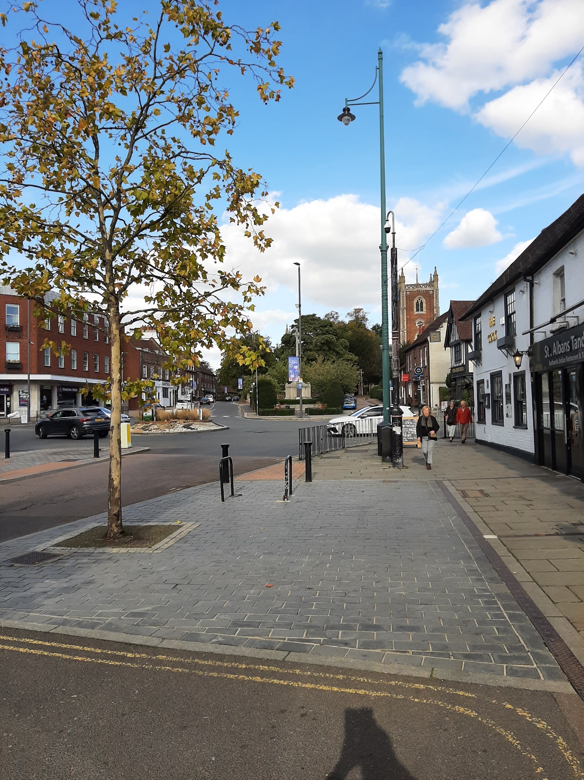
St Peter’s Church
The top end of St Peter’s Street, with the tower of St Peter’s visible in the centre-left of the photograph
Notes:
All images taken by the authors

Slide 2
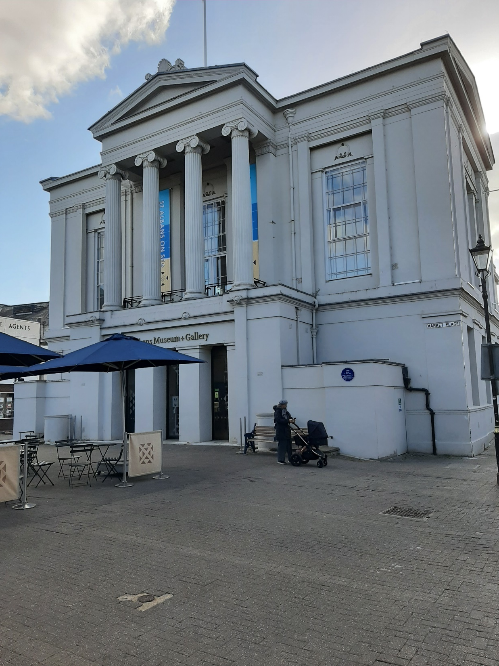
Town Hall
The current Georgian building is now believed to be built on the site of the medieval Moot Hall, where John Ball was tried in 1381

Slide 3
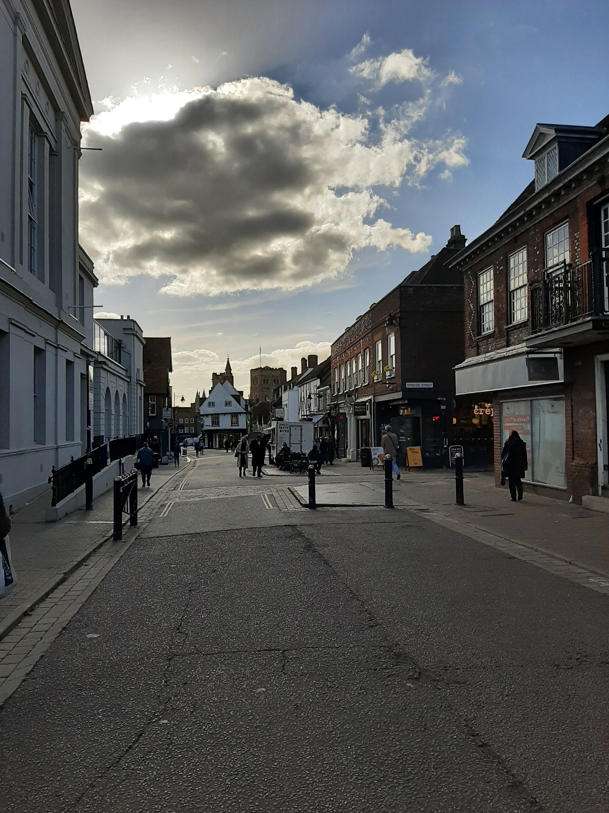
View of St Albans Abbey down St Peter’s Street, with the Town Hall on the left-hand side

Slide 4
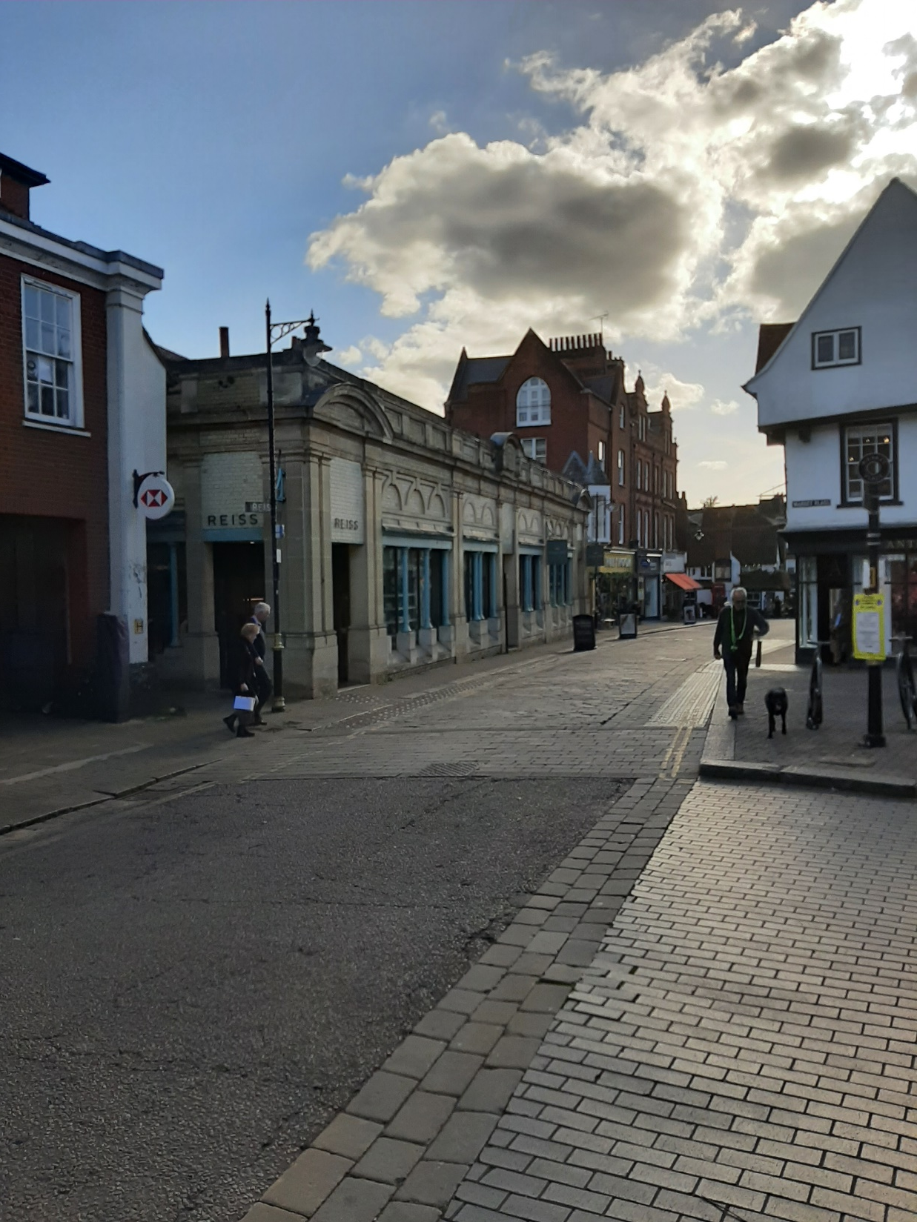
View of the Corn Exchange, where an act of civil disobedience began over the public right of way from Waxhouse Gate towards the Abbey

Slide 5
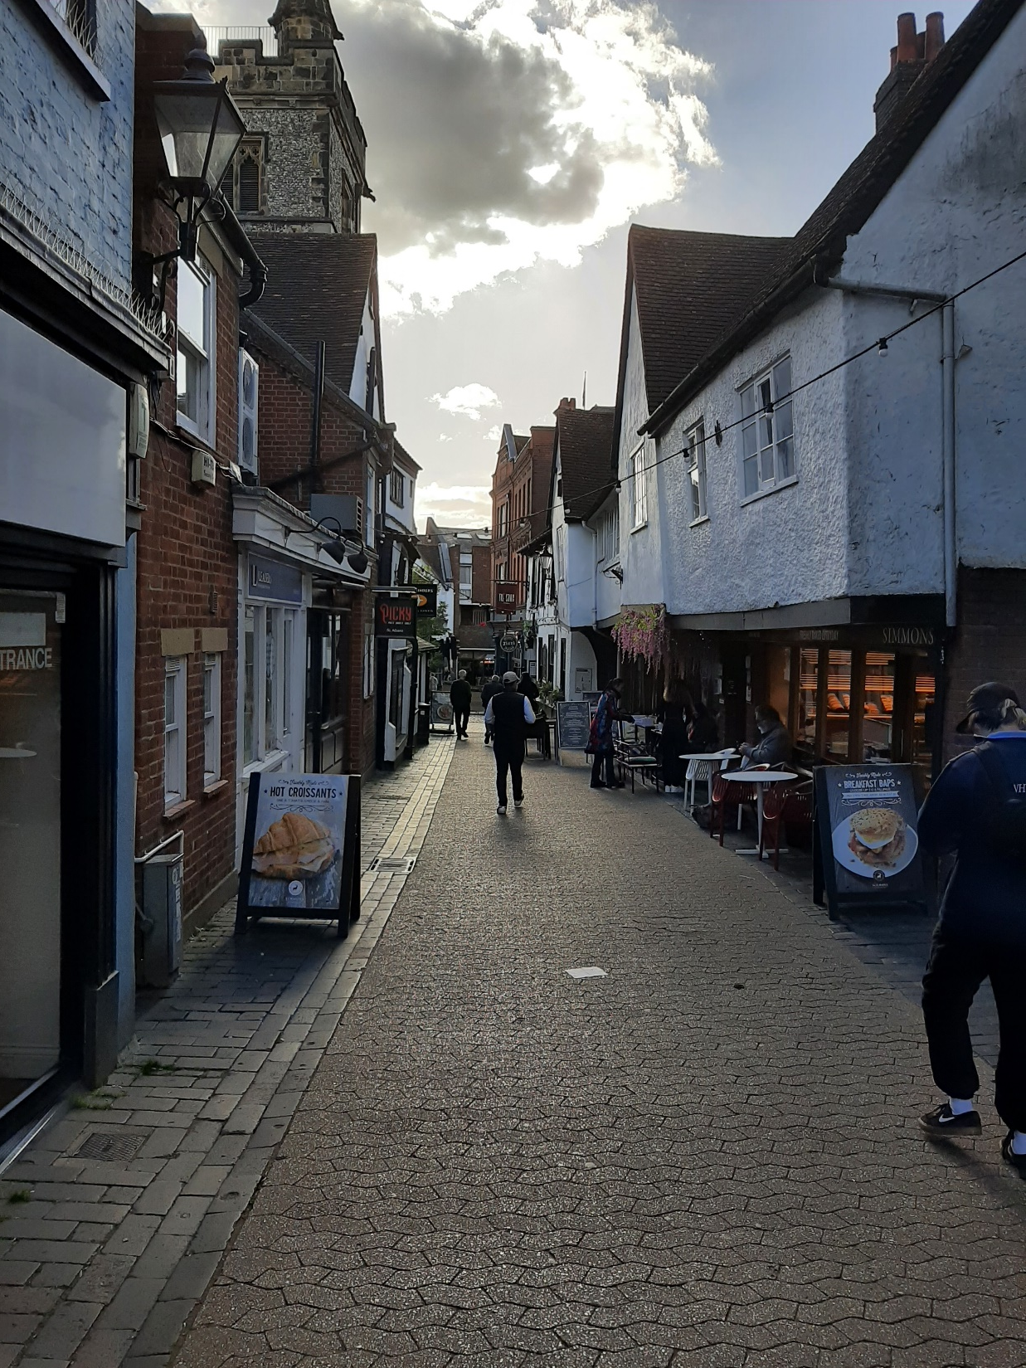
View down French Row

Slide 6
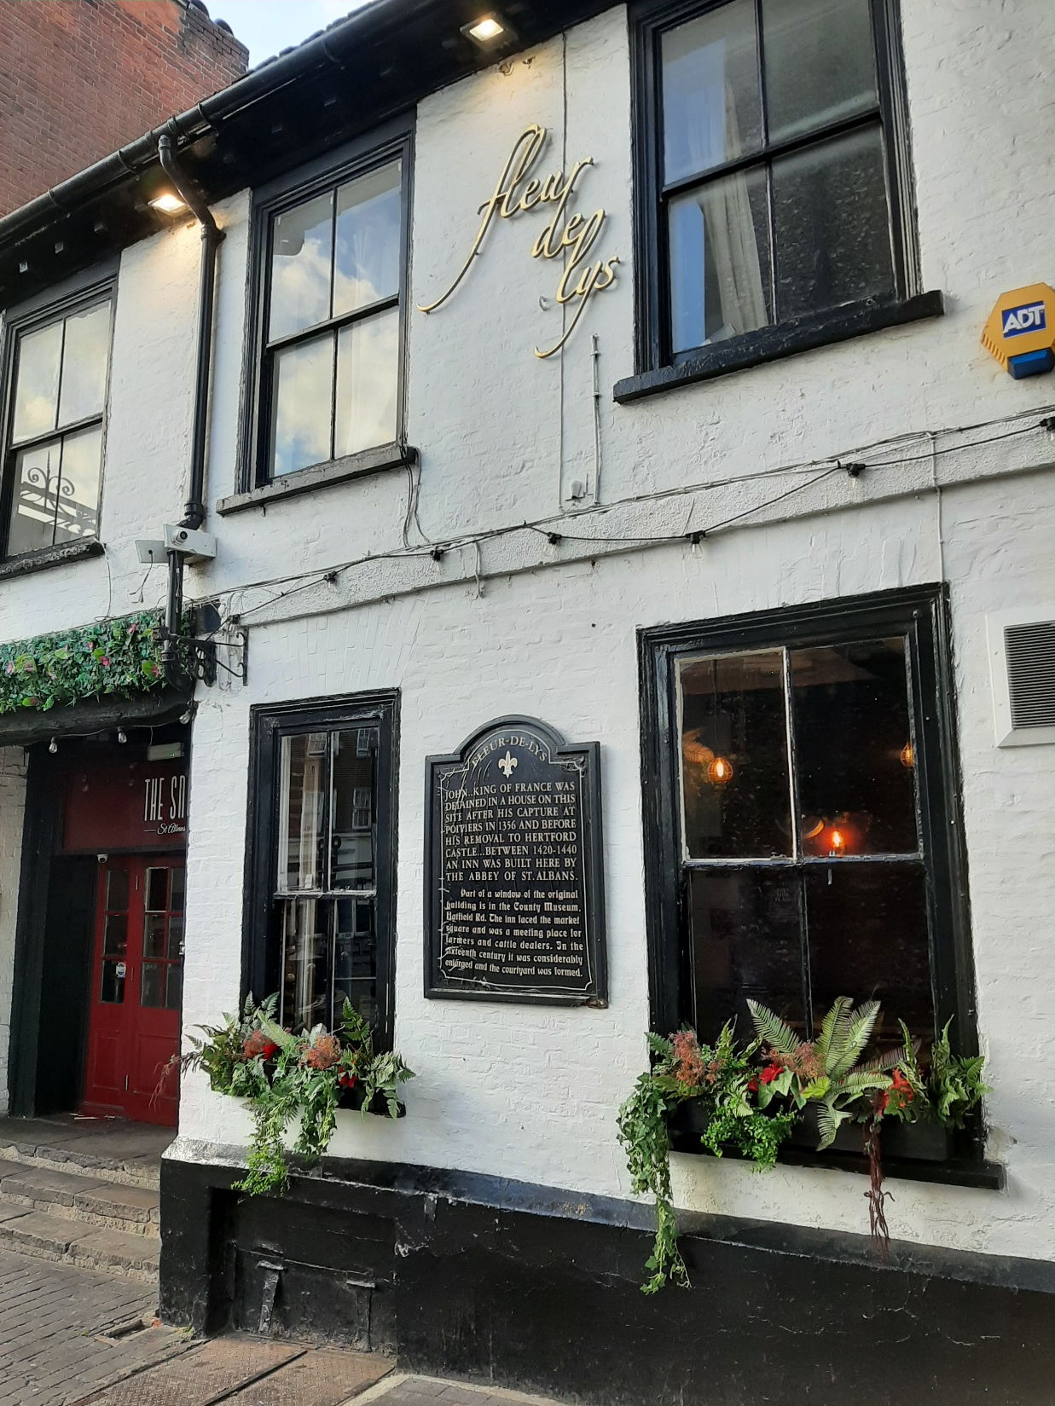
Fleur de Lys Inn

Slide 7
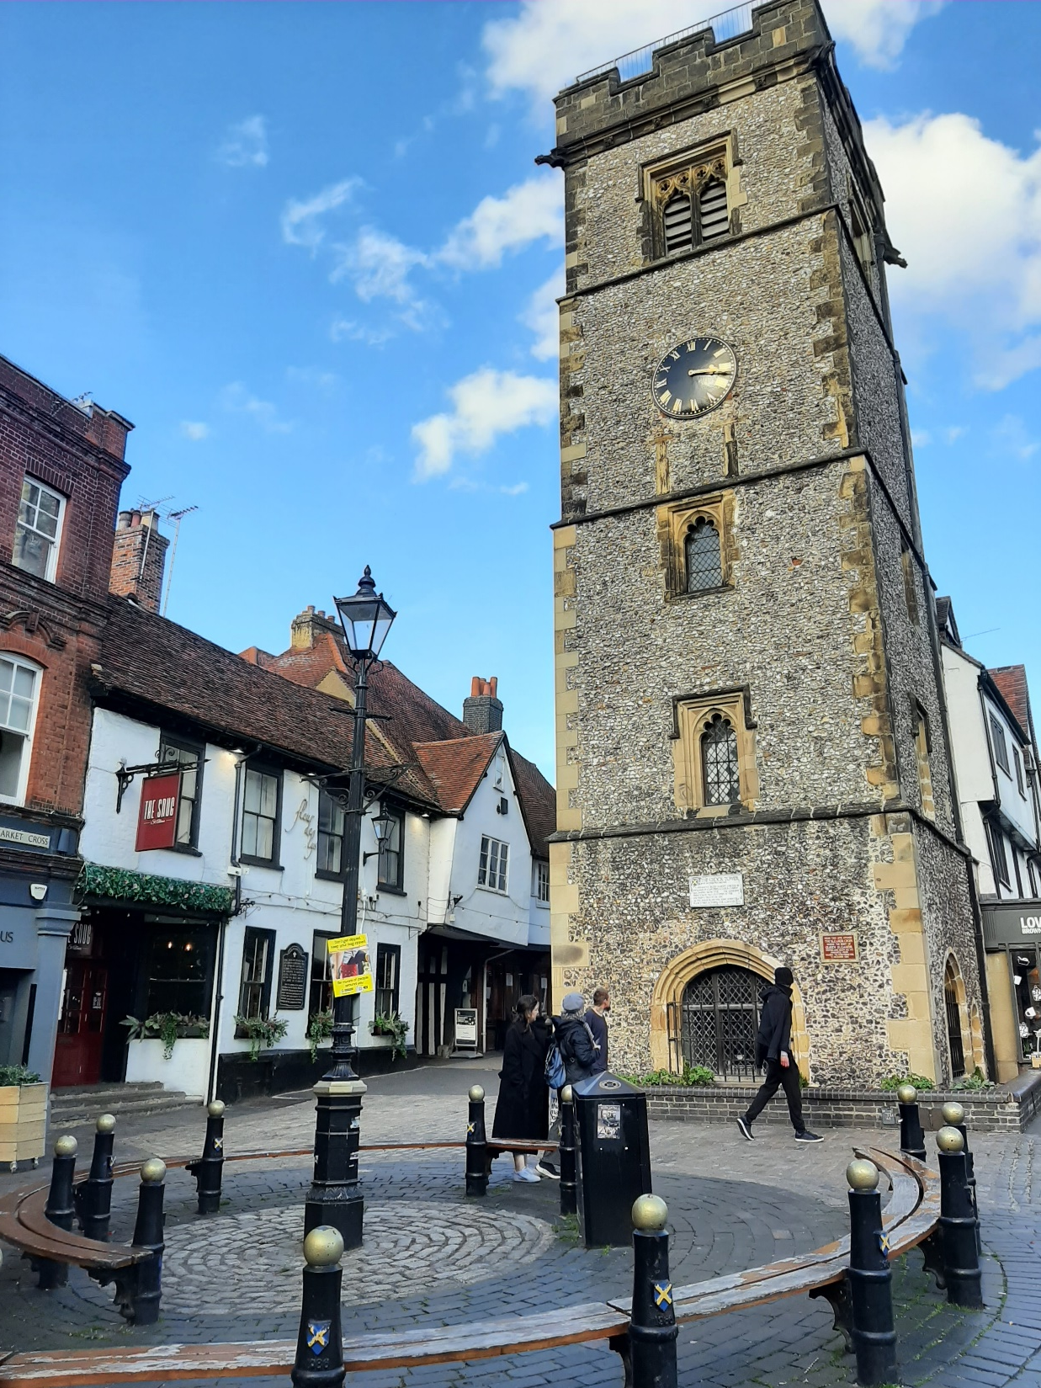
Clock Tower
While the Clock Tower was built in the decades after the Revolt, the space was the original market place and where documents from the Abbey were burned

Slide 8
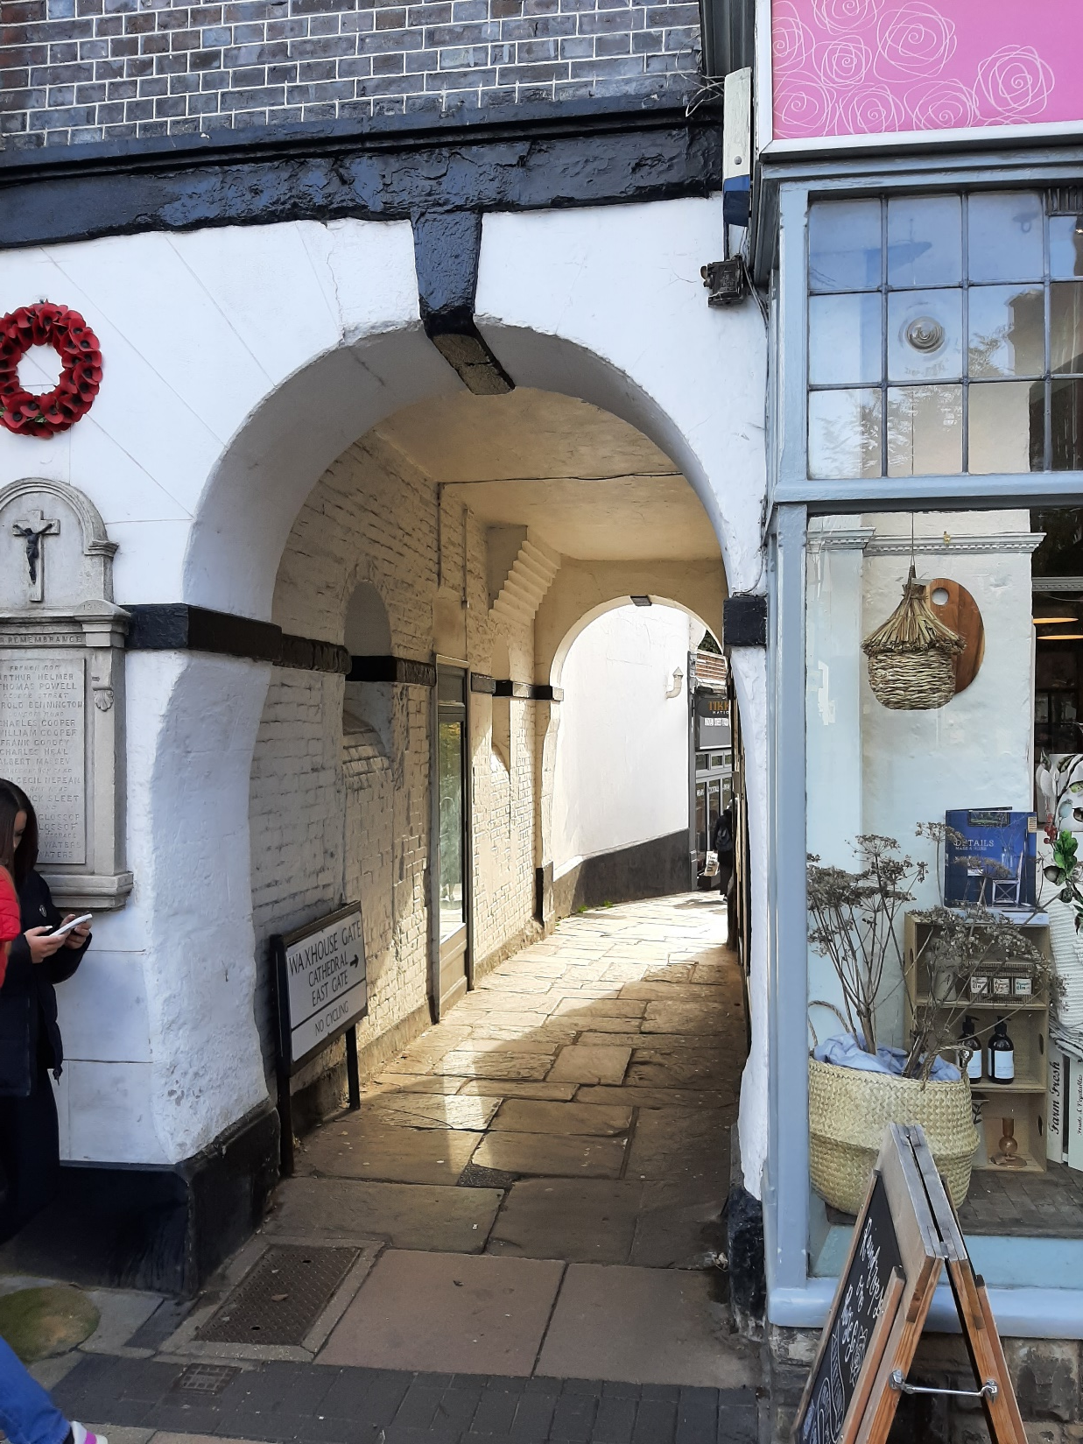
Waxhouse Gate, accessed from the opposite side of George Street

Slide 9
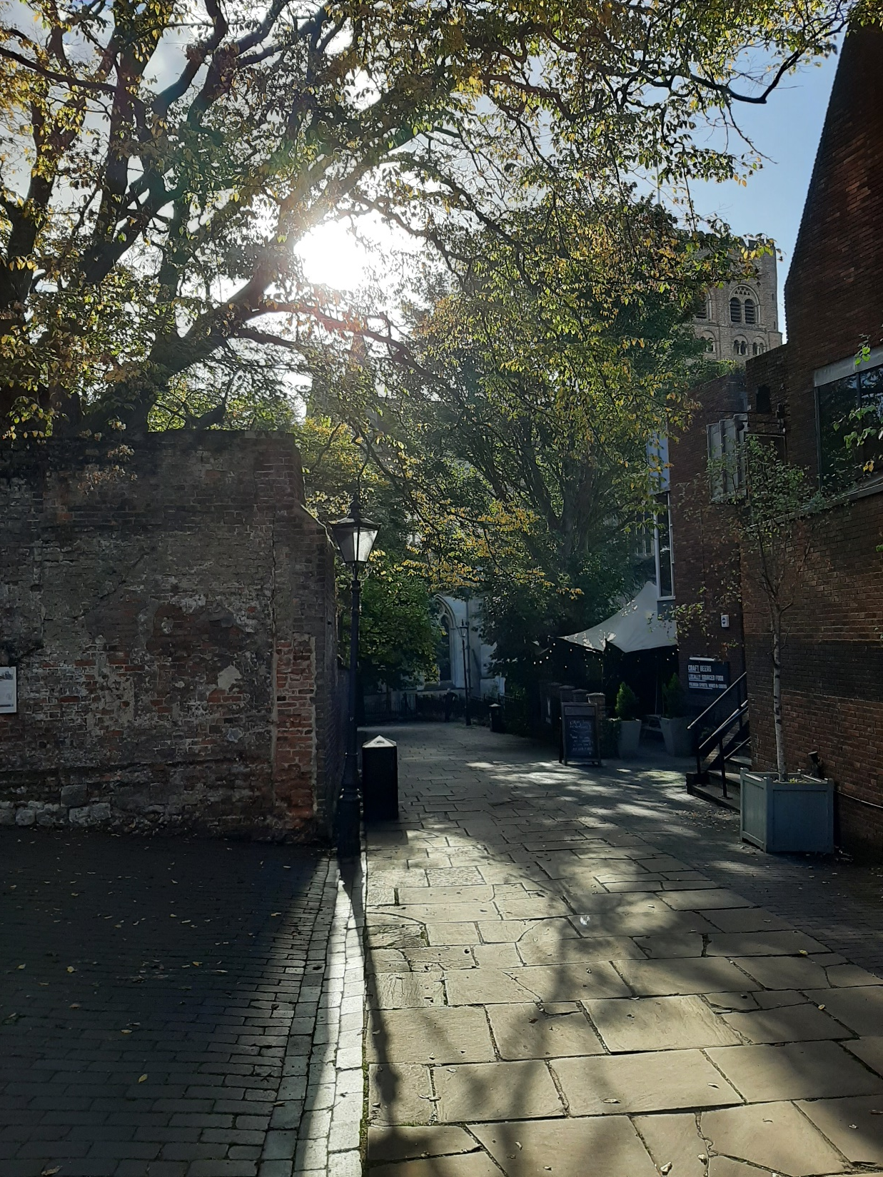
The public right of way towards the Abbey from Waxhouse Gate

Slide 10
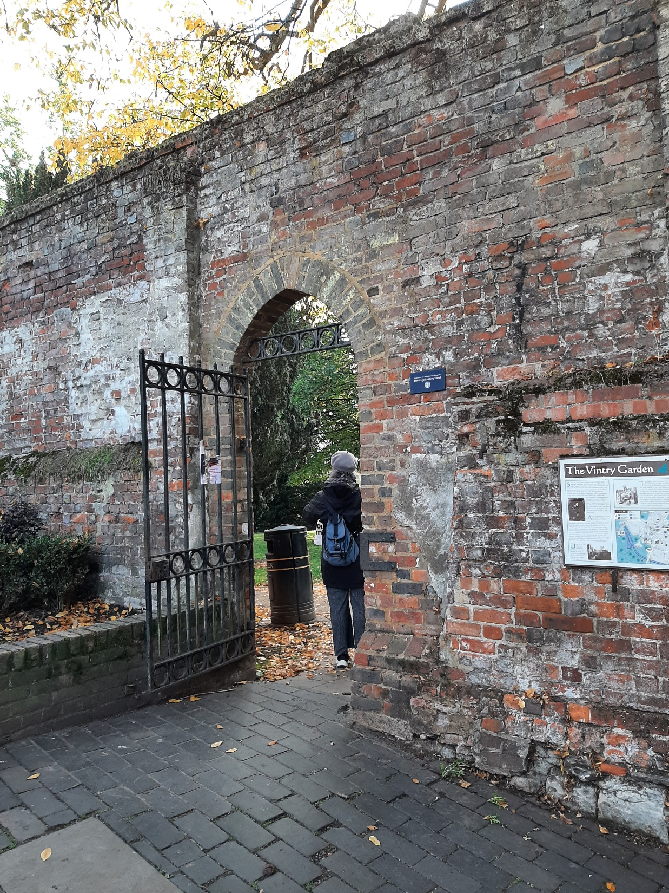
3.
Vintry Garden

Slide 11
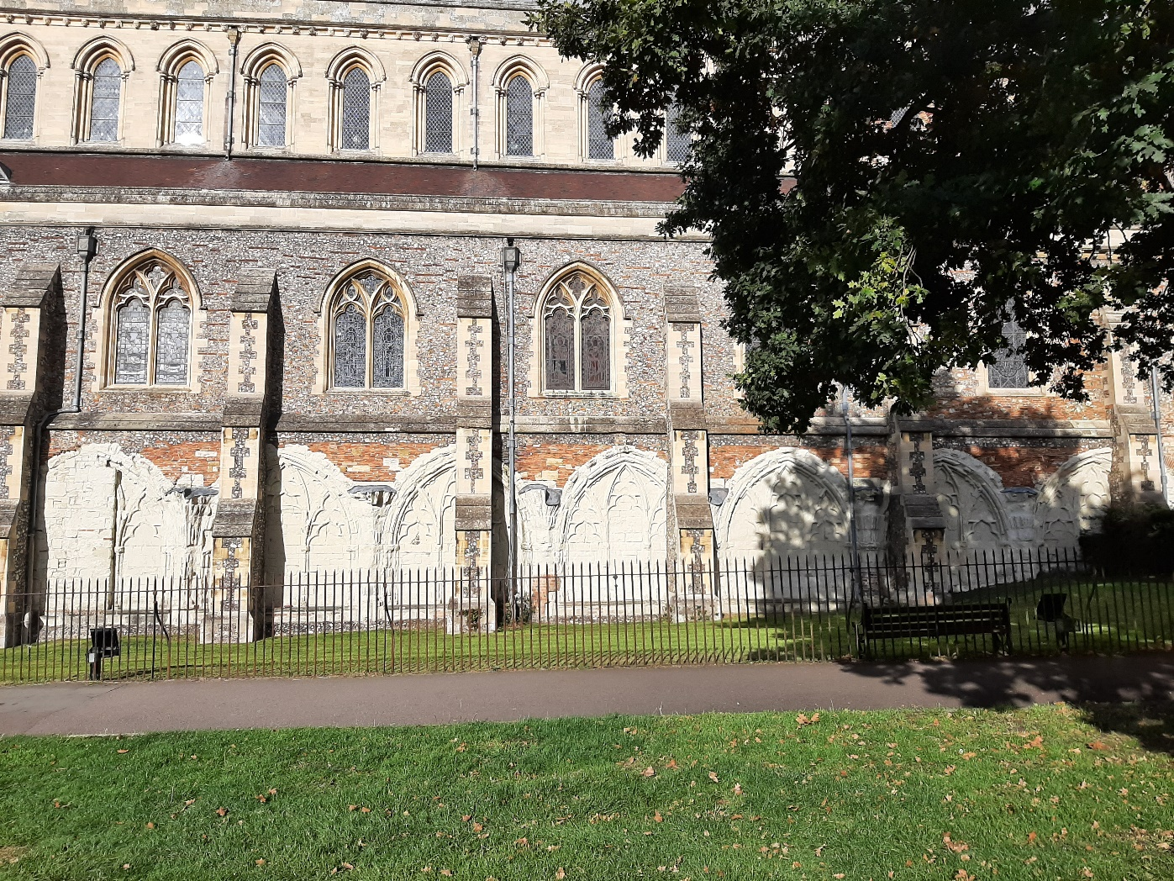
The cloister and Abbot’s Parlour

Slide 12
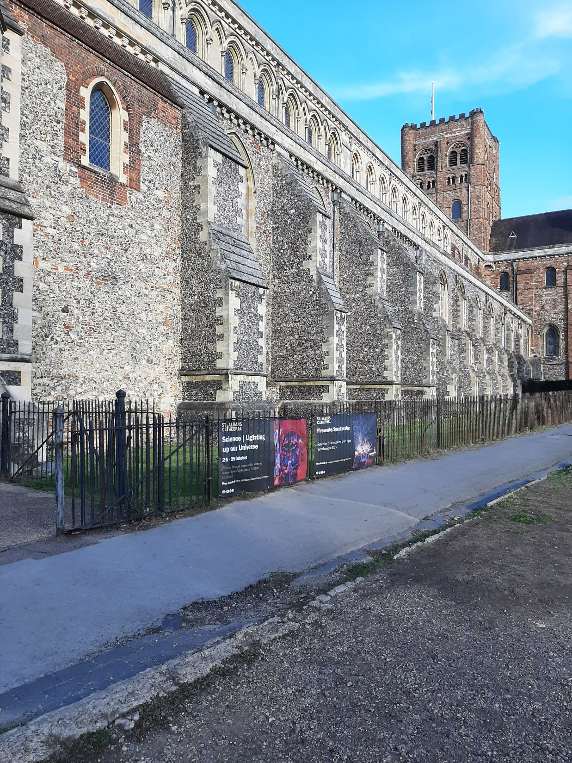
The cloister and Abbot’s Parlour

Slide 13
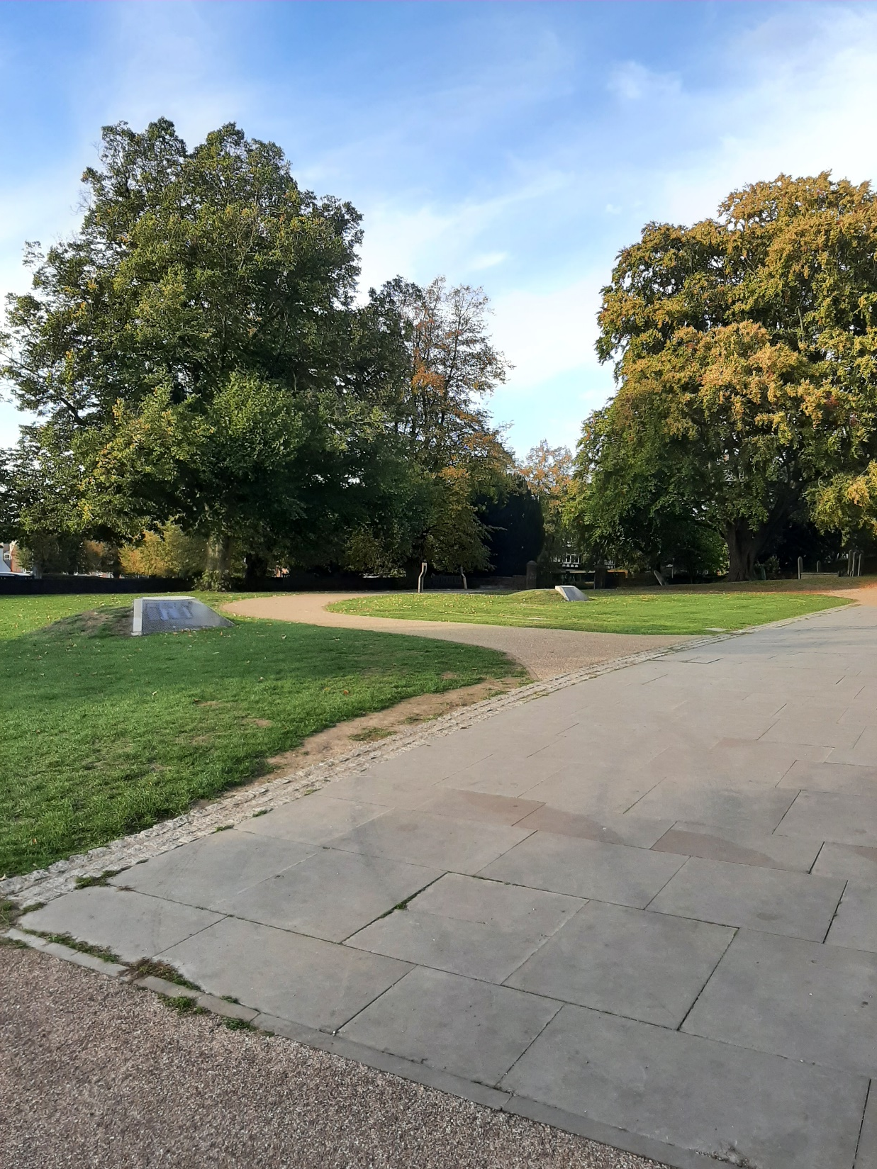
West entrance/Abbey gaol

Slide 14
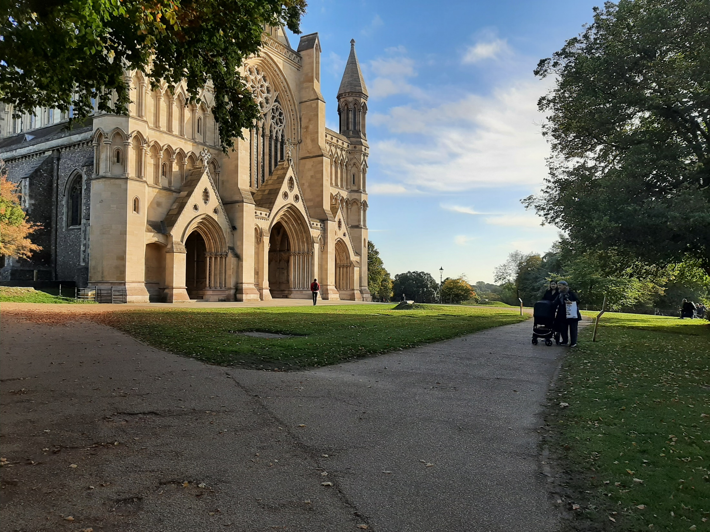
West entrance/Abbey gaol

Slide 15
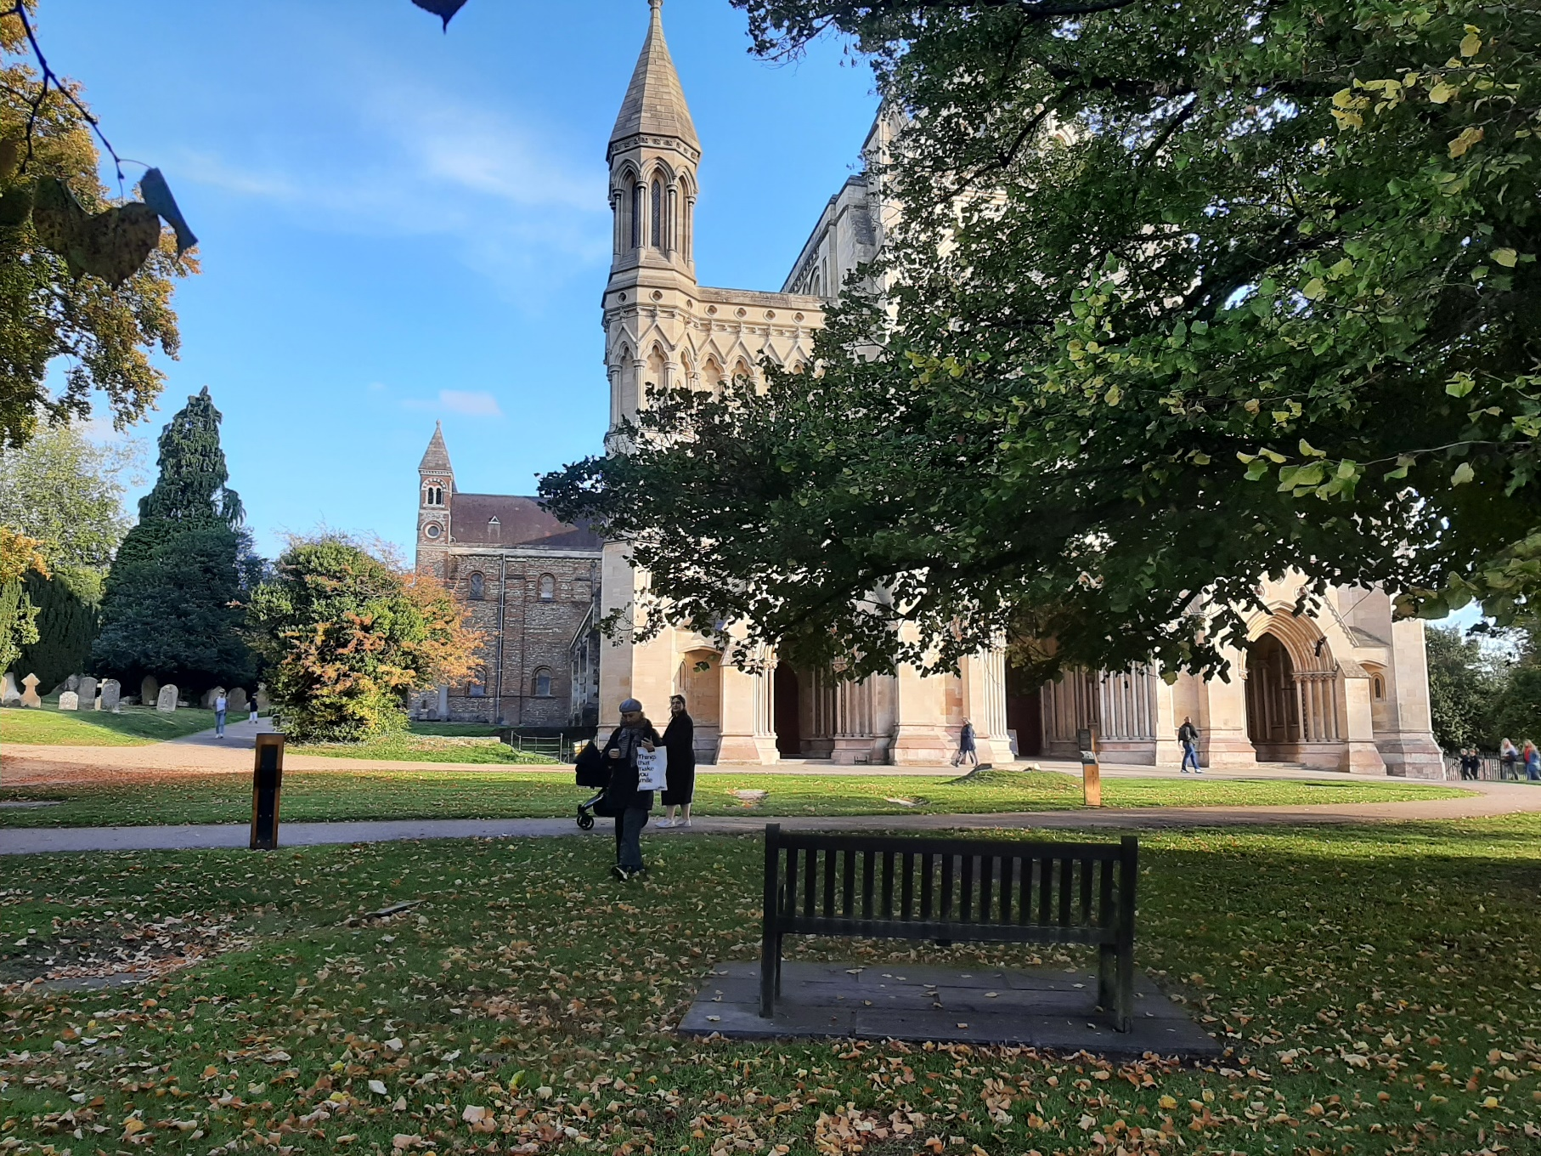

Slide 16
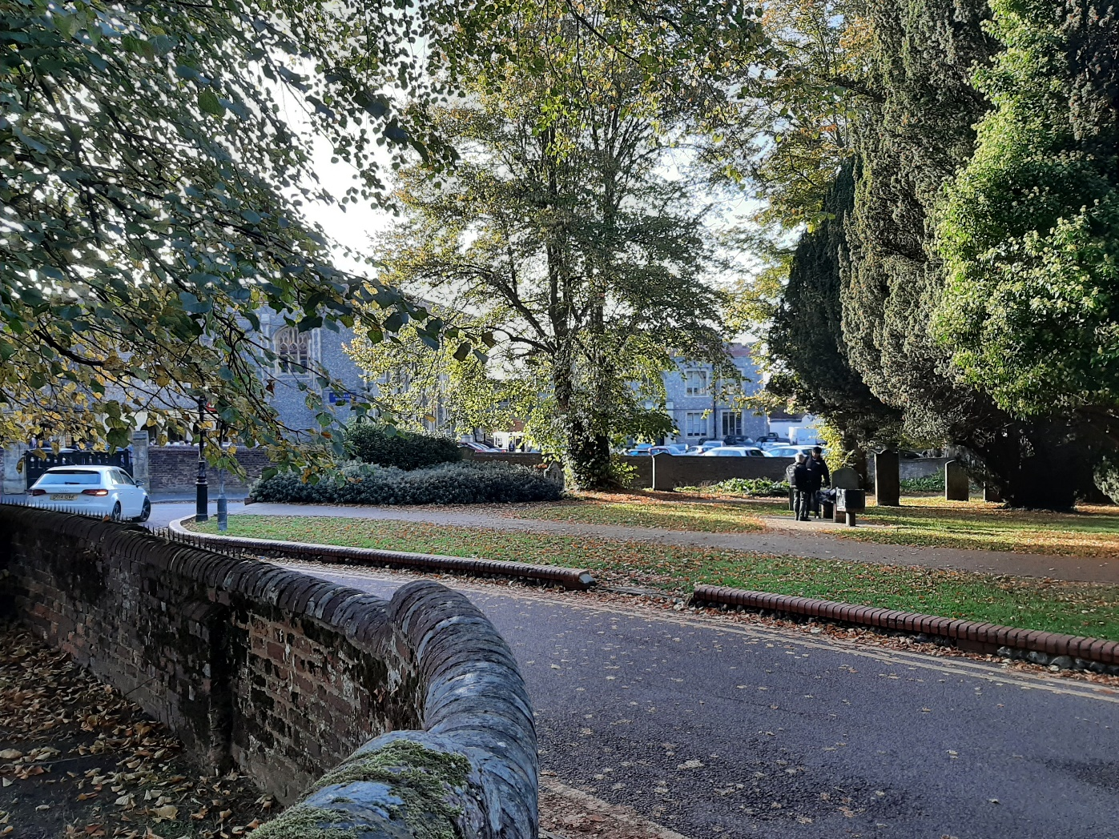
Romeland

Slide 17
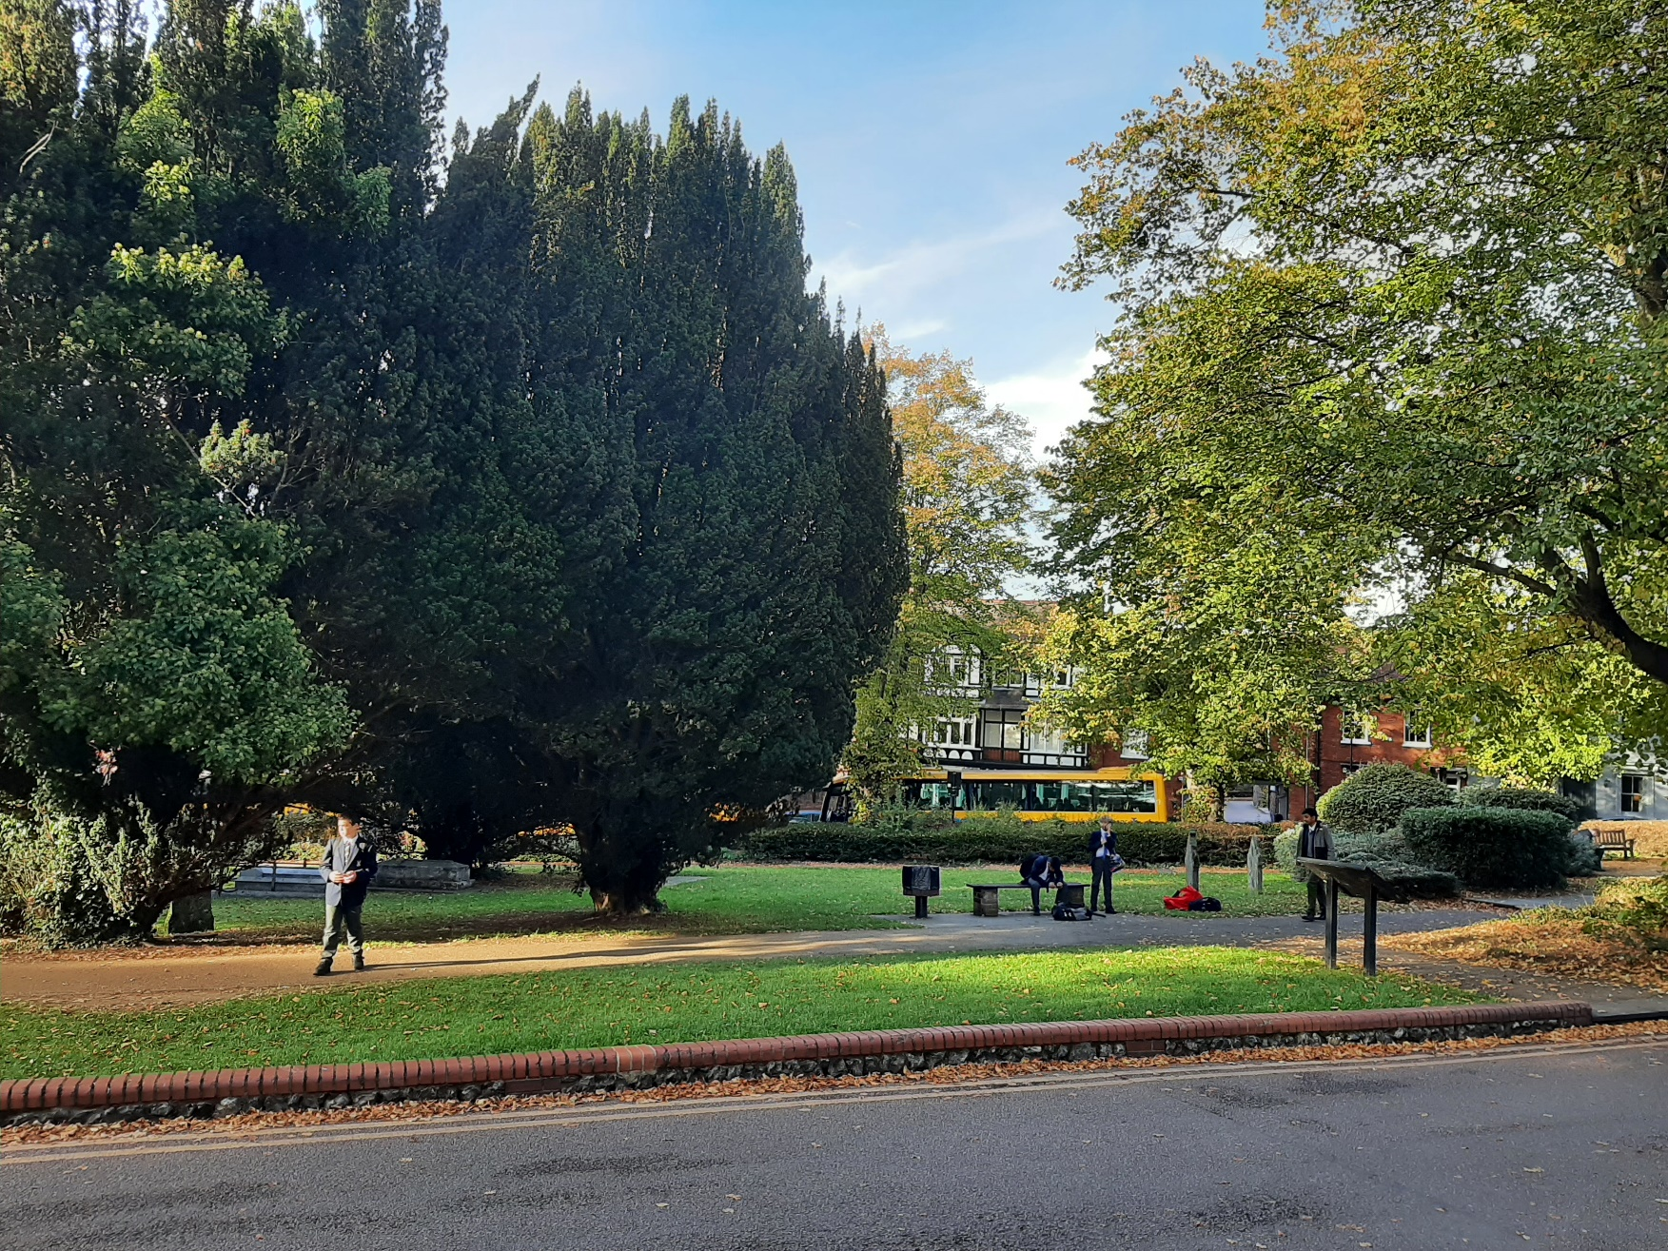
Romeland

Slide 18
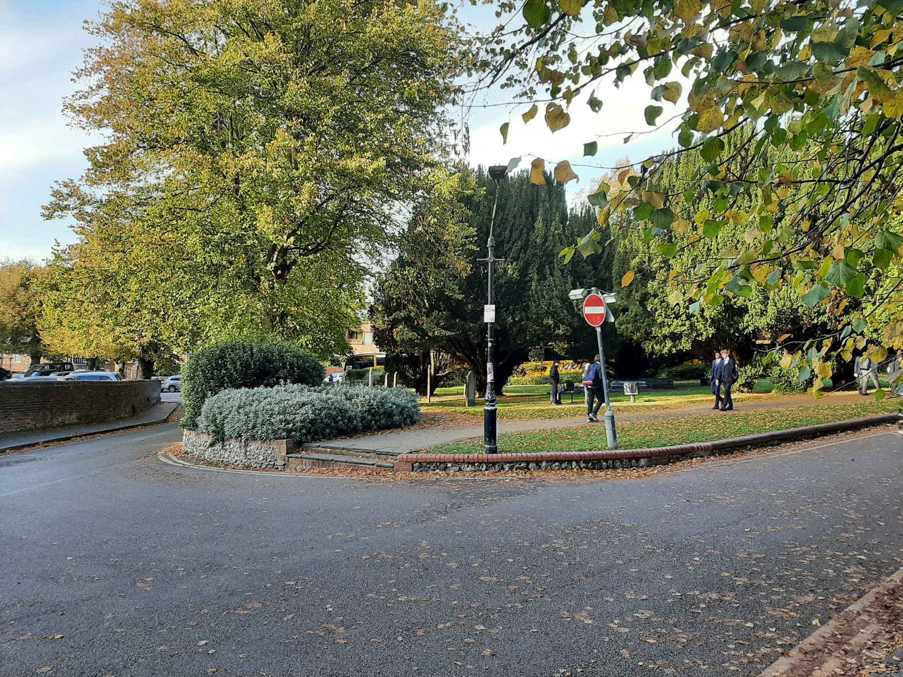
Romeland

Slide 19
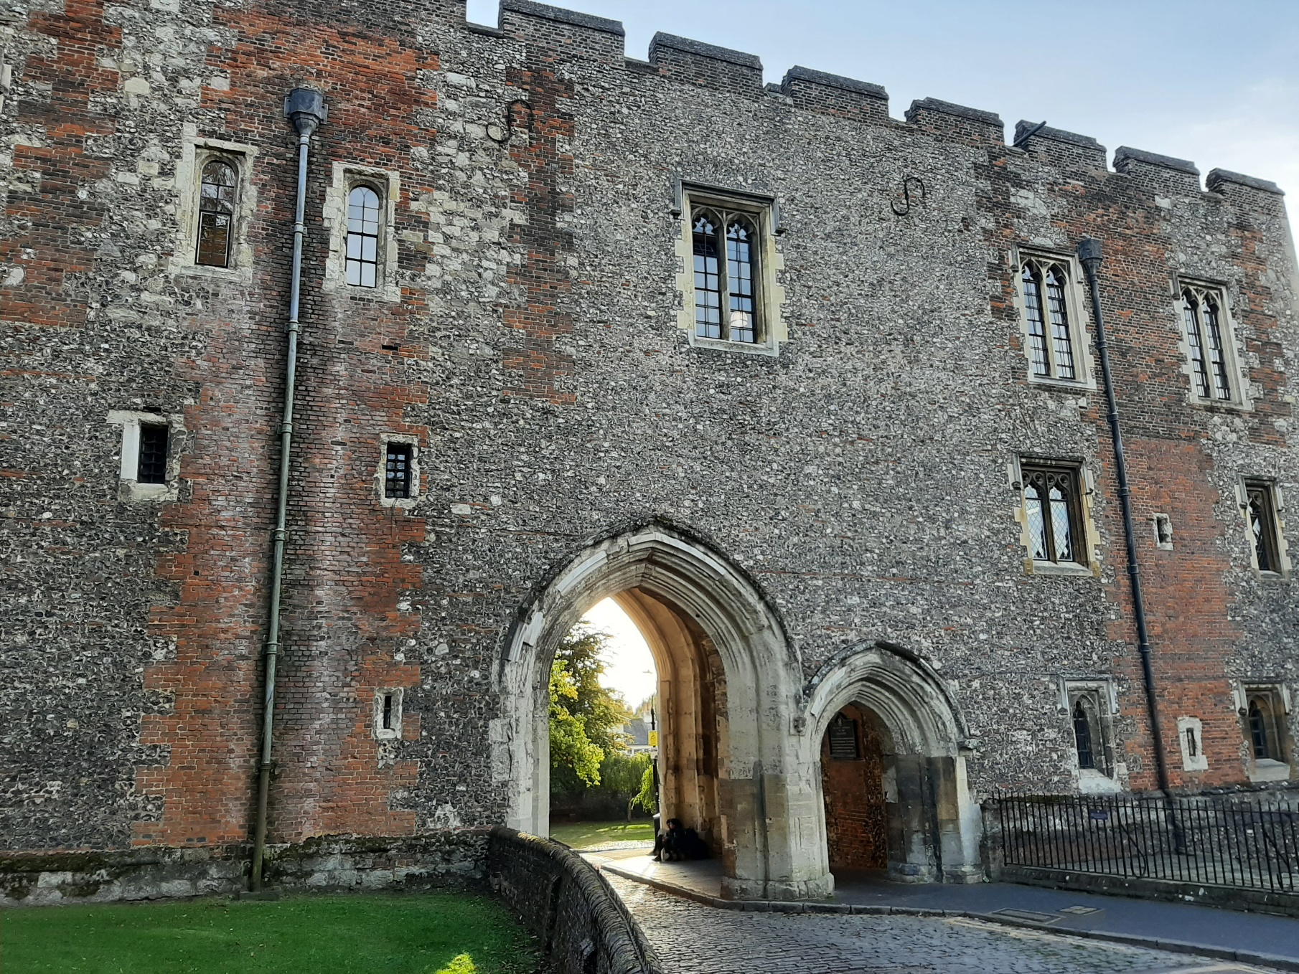
The Great Gateway

Slide 20
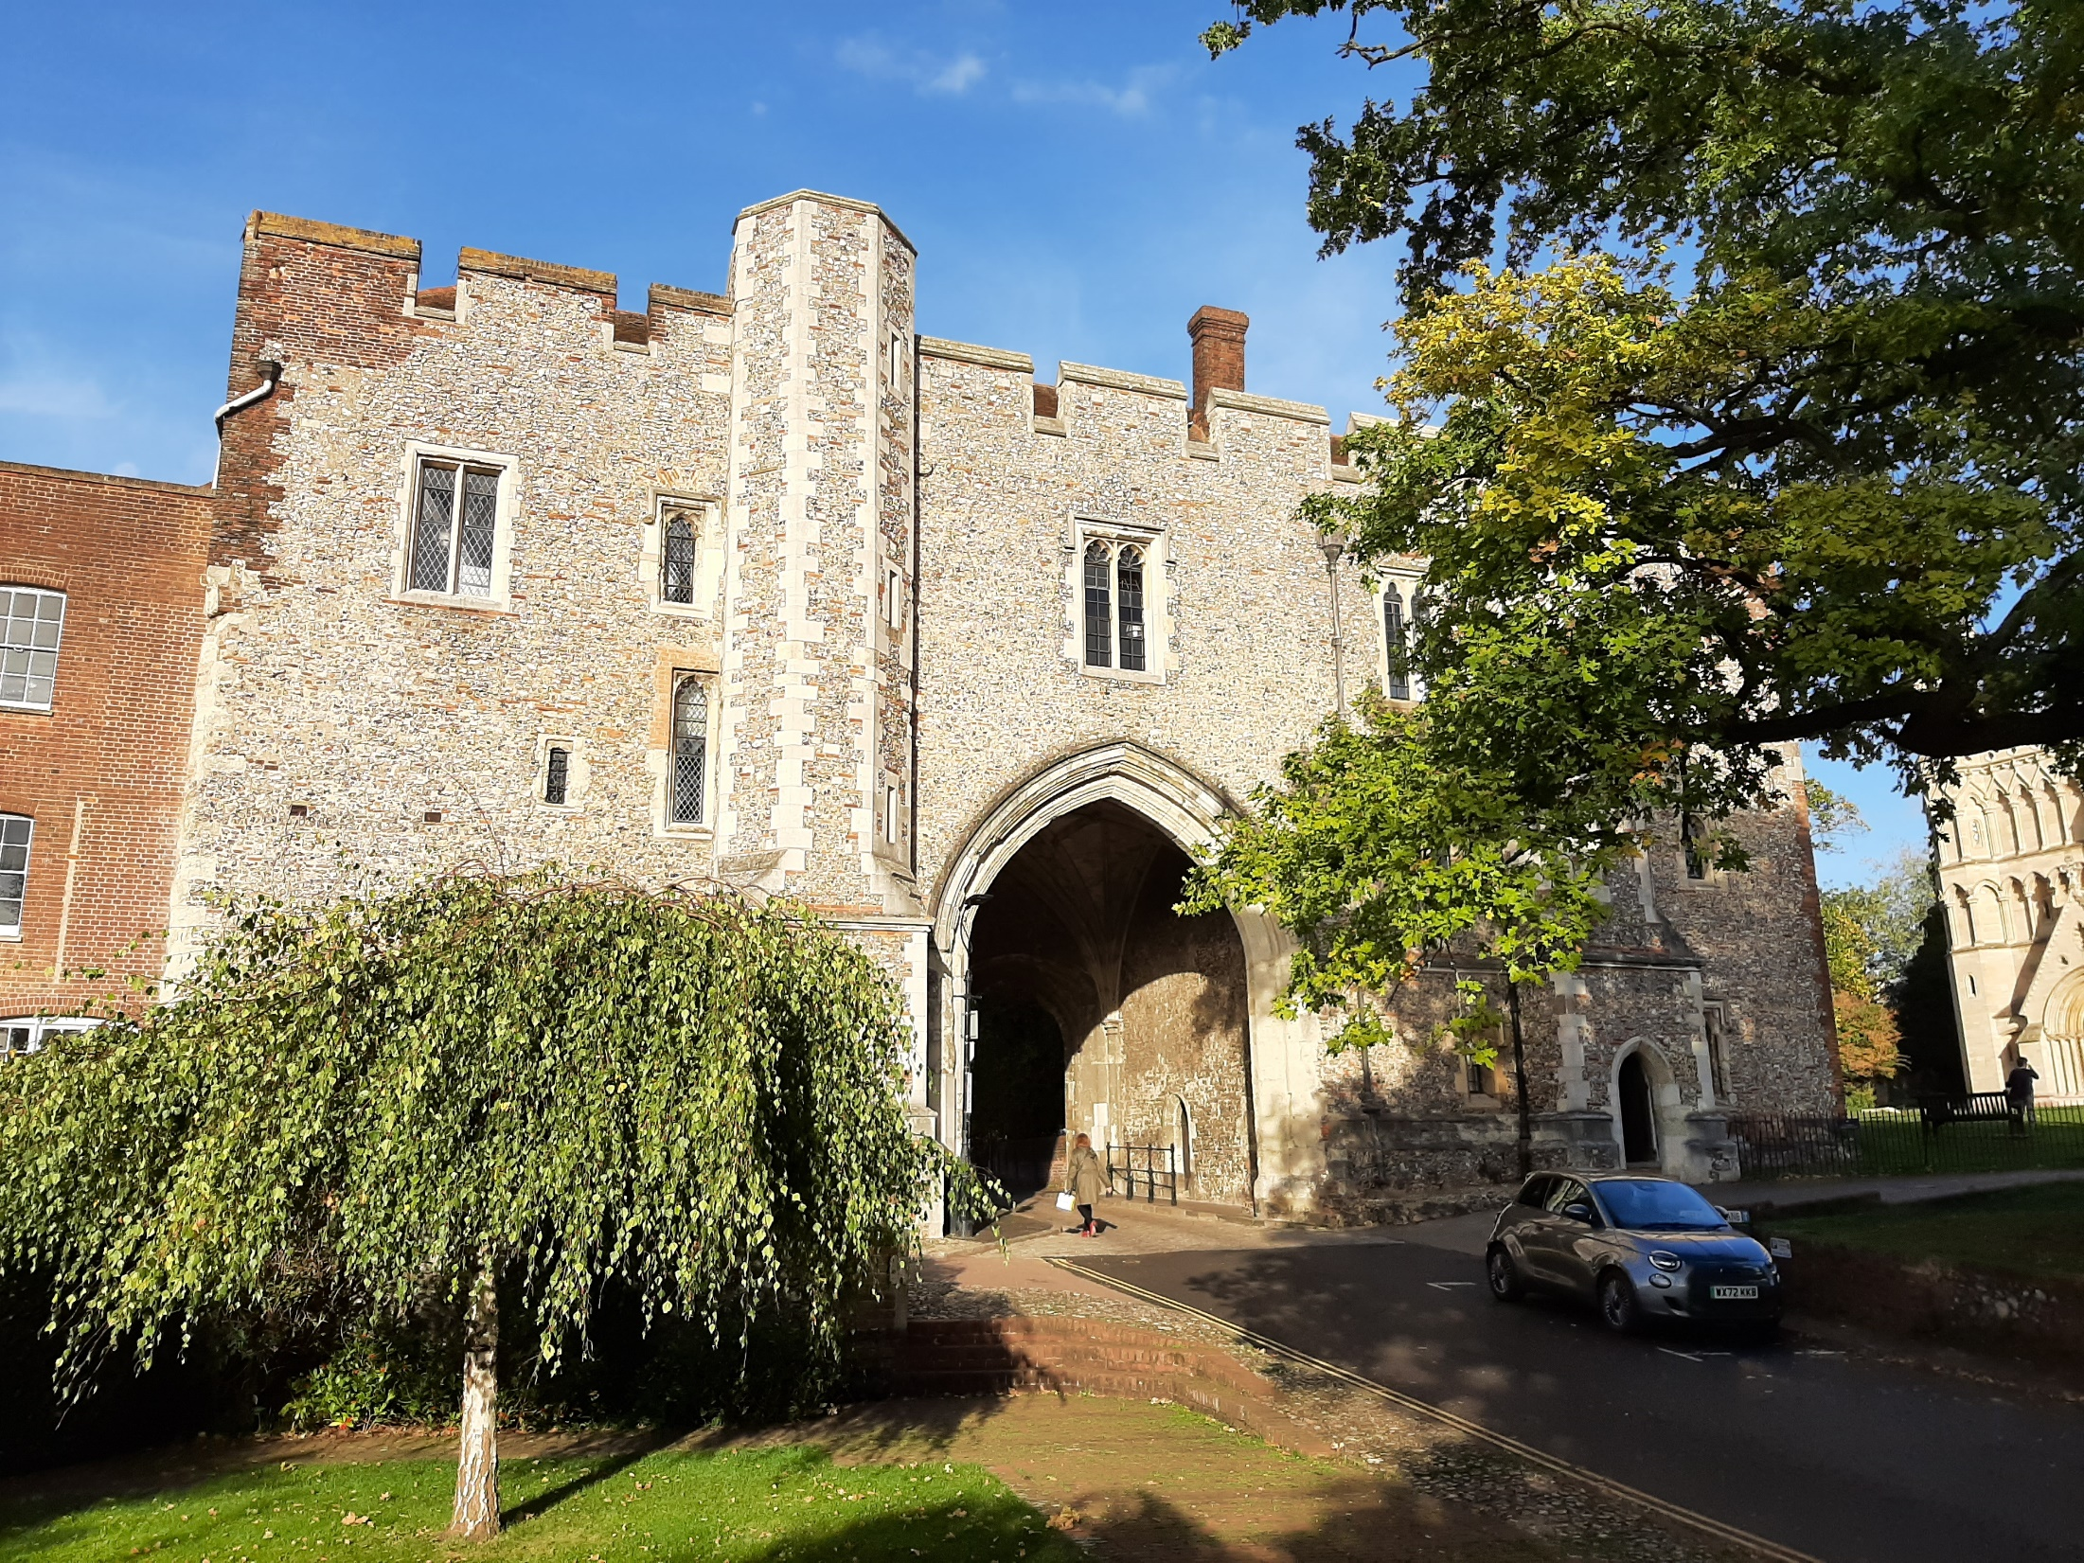
The Great Gateway

Slide 21
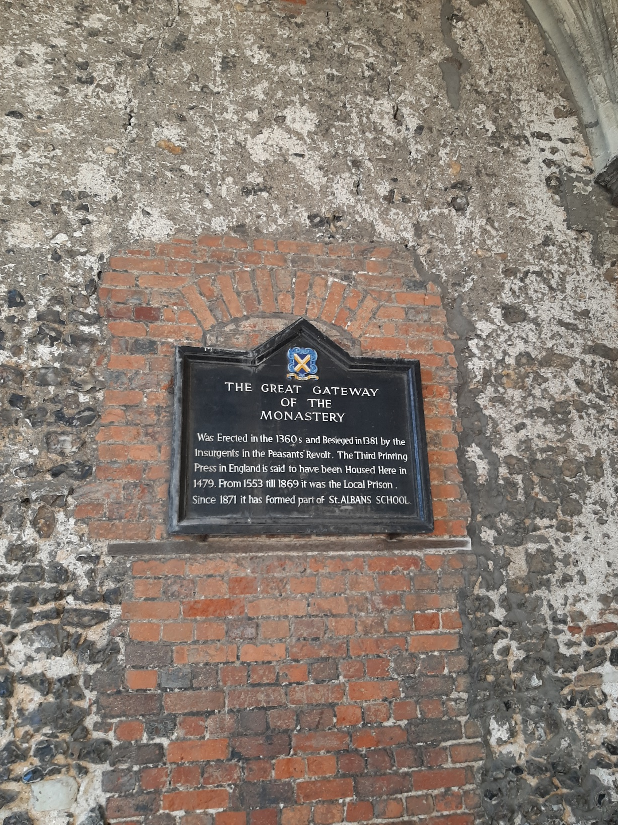
The Great Gateway

Slide 22
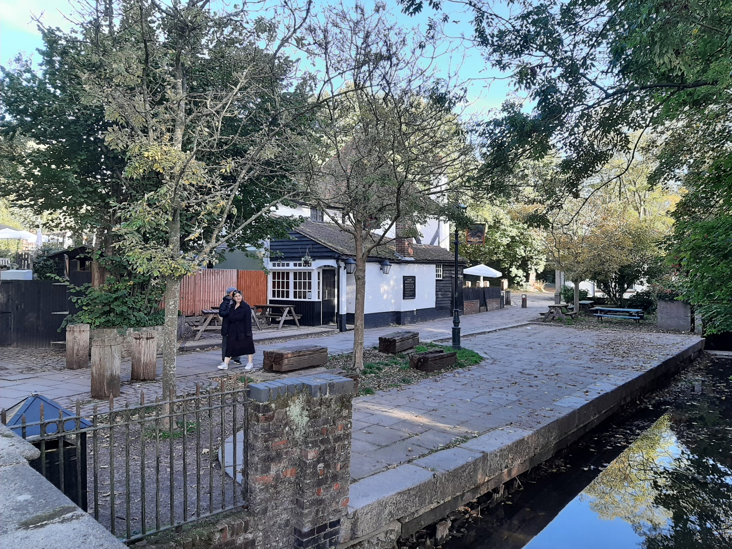
Ye Olde Fighting Cocks

Slide 23
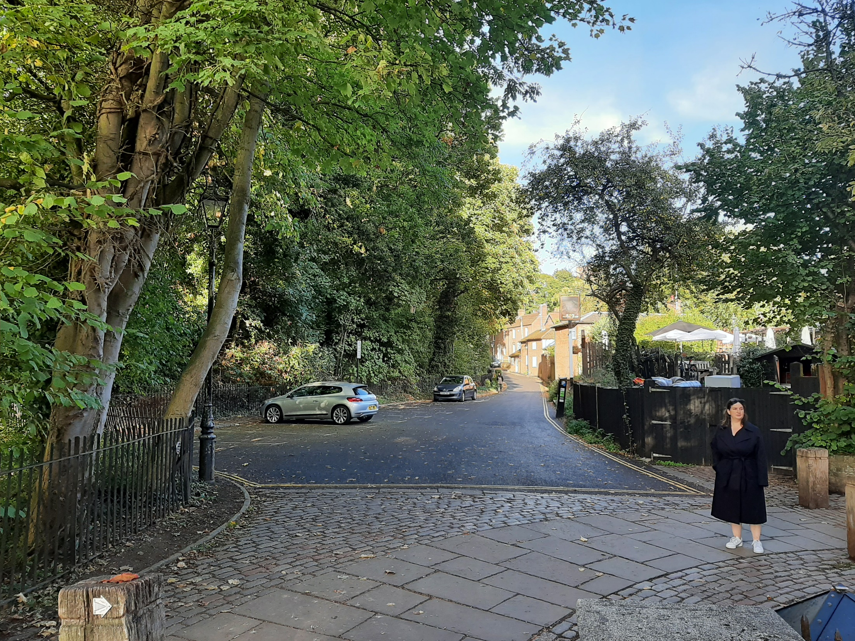
Ye Olde Fighting Cocks
Entrance to the Abbey grounds and site of a medieval fishpool owned by the Abbey

